Slide 1

Computer Graphics and Game Development
Inkscape 1
2016 Fall

Slide 2
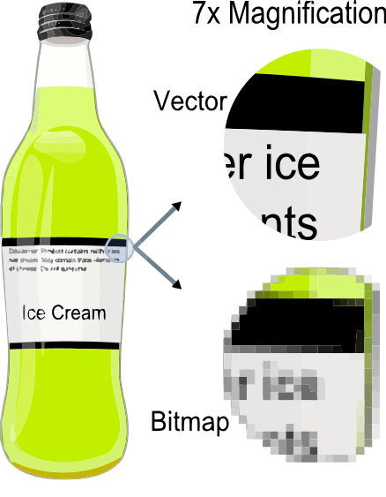
Images versus Vector Graphics
Vector Graphics:
Consist of shapes (dot, line, triangle, square etc.)
Zoom in w/o blurring
Easy to add/delete components
Bitmap (Images, picture, photo)
Consist of pixels
From camera, imaging devices
Hard to add/delete components
Getting blurry when zoomin

Slide 3

Images versus Vector Graphics
Images
Vector

Slide 4

Inkscape: software for Graphics Design

Slide 5
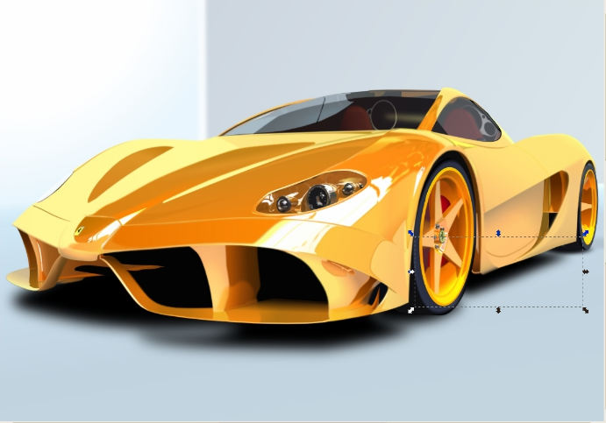
Inkscape Arts

Slide 6
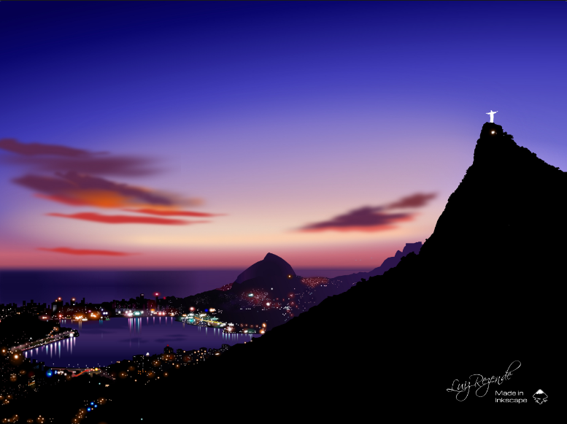
Inkscape Arts

Slide 7
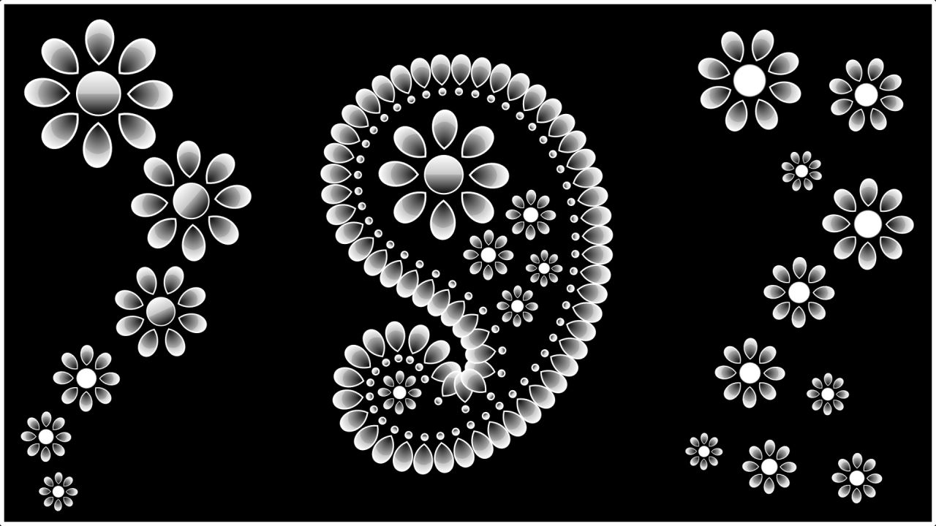
Inkscape Arts

Slide 8


Inkscape Arts

Slide 9
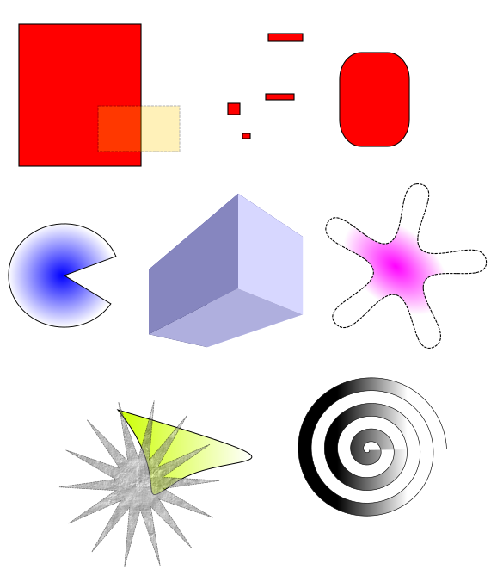
Basic Shapes

Slide 10
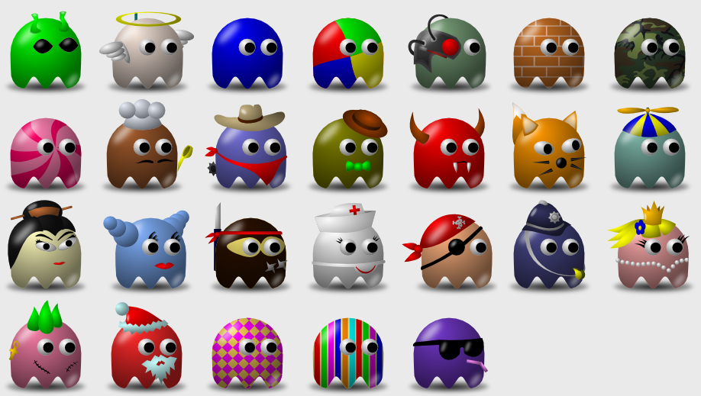
PacMan

Slide 11

Design PacMan in Inkscape
Highlight
Eyes
Face
Highlight
Shadow

Slide 12
Design PacMan in Inkscape
Highlight
Eyes
Face
Highlight
Shadow

Slide 13
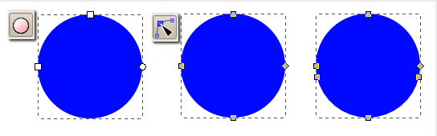
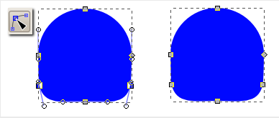
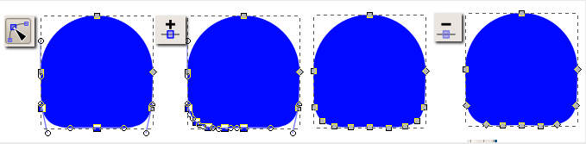
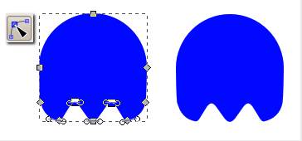
PacMan: face shape
Draw a circle using the ellipse tool (keep the Ctrl key pressed while dragging to get a circle) and then convert the circle to path (Path > Object to Path). Convert to the node editor and add (by double-clicking) two nodes near the extreme left and right nodes of the circle.
Select the two newly created nodes (with Shift) and drag them to the bottom (keep the Ctrl key pressed while dragging to restrict the movement to the vertical).
Select the newly created left node and the bottom node and press twice the insert new node button. Do the same for the right side. Each segment will be split with 3 new nodes. You may now delete the left and right segmenting nodes to simplify the shape.
Select (with Shift) the two nodes left and right nearest to the original bottom node and move them up a bit (with Ctrl key pressed, to restrict the movement to the vertical). This is the "ghost" shape.

Slide 14
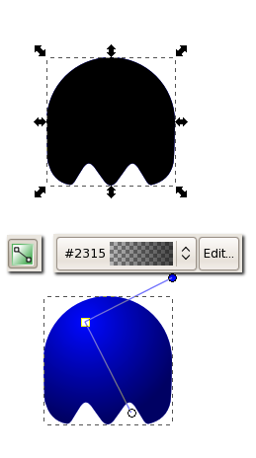
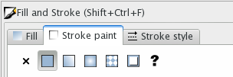
PacMan: face shading
Duplicate the ghost shape and make the duplicate black. Change the black color with a radial gradient going from completely transparent black at the center to partly transparent black at the margins. Move the center of the gradient up and left to have a light source.

Slide 15
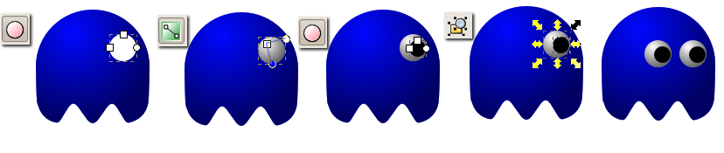
PacMan: eyes
For the eye create a white circle, duplicate it and fill the duplicate with the same radial gradient. Add a smaller black circle. Group them, duplicate the group to get the second eye.

Slide 16
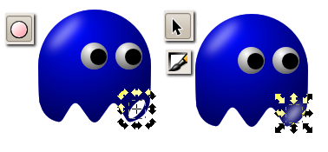
PacMan: highlights
Add a highlight: create an white ellipse, move it the to target location, rotate a bit apply some blur and reduce the opacity.

Slide 17
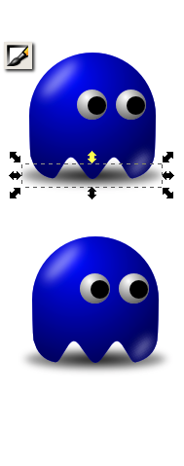
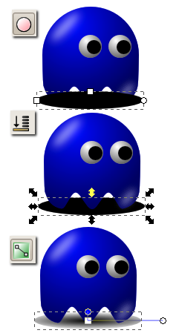
PacMan: shadow
For increased realism, add a shadow: a black ellipse at the bottom, move it below the rest of the graphic and fill with a radial gradient going from solid black at the center to partly transparent black at the margins.
Now we are done.

Slide 18
PacMan: Inkscape to Javascript
Save as HTML5 to get Javascript code to draw on HTML5 canvas.

Slide 19
Exercise
Try out all shape tools.
Make a PacMan by yourself following the instructions.

